Slide 1
Mild and Moderate and Severe TBI, Oh My! What’s a teacher to do?
Michael Mohrland, PsyD, ABPP
University of Missouri
Spring Collaborative Conference
Columbia, MO 2019

Slide 2
TBI School Functioning

Slide 3
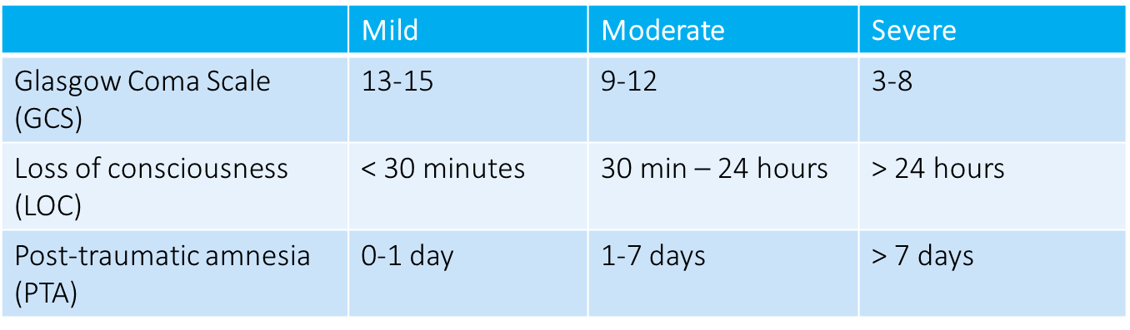
Severity of TBI Scale

Slide 4

Current Concussion Definitions:
CDC (WHO, ACRM)
independent.ie
“Mild Traumatic Brain Injury”
Acute brain injury resulting from mechanical energy to the head from external physical forces including:
  1) 1 or more of the following:
    Confusion/disorientation
    LOC 30 minutes or less
    PTA less than 24 hours
    Transient neurological abnormalities (focal signs, sx, seizure)
  2) GCS 13-15 after 30 minutes post-injury or presentation for healthcare

Slide 5
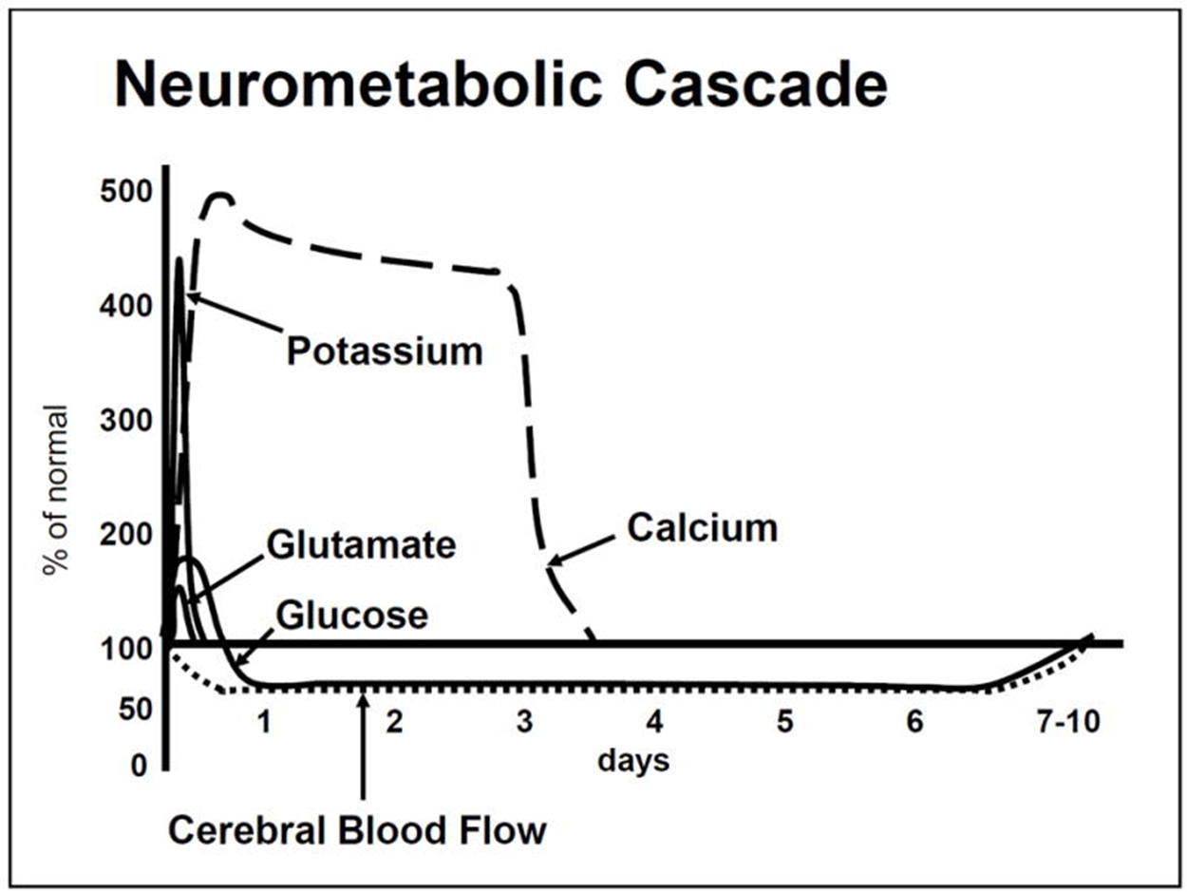
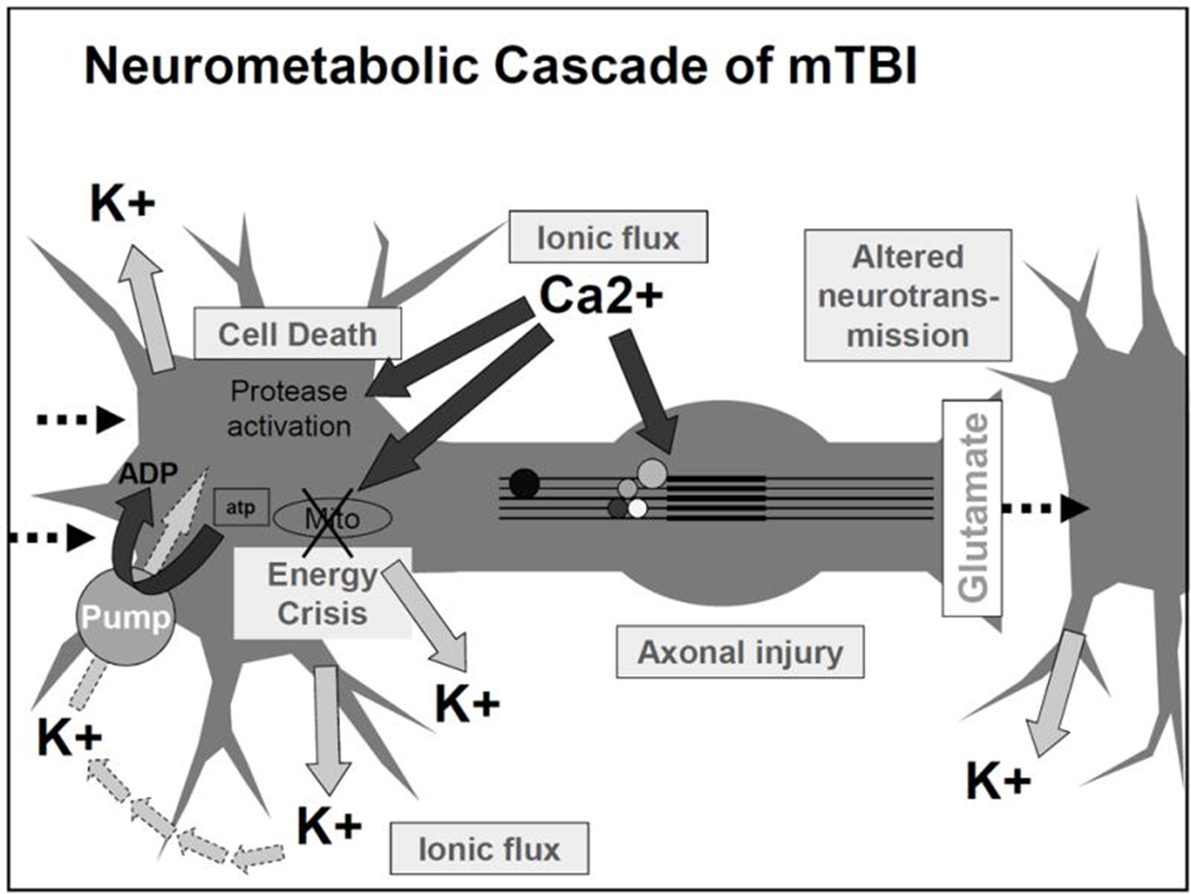
At least a Neurometabolic Cascade
(Giza & Hovda, 2001, 2014)
Acute Effects:
Ionic flux & glutamate release
Energy crisis
Levels of Injury:
Functional (physiological)
Microstructural (physical)

Slide 6
Concussion Symptoms
  Headaches (93.4%)
  Dizziness/unsteadiness (74.6%)
  Concentration (56.6%)
  Vision changes/photophobia (37.5%)
  Nausea (28.9%)
  Fatigue/Drowsiness (26.5%)
  Phonophobia (18.9%)
  Tinnitus (10.7%)
  Irritability (9.2%)
  Sleeping problems
  Depression
  Memory problems
  Slowed thinking
  Word finding problems
Meehan, d’Hemecourt, & Comstock, Am J Sports Med, 2010

Slide 7
Cognitive Signs
Attention
Processing Speed (RT)
Emotional/Behavioral
Memory
Intellect
Academic
Language
Executive functioning
    Working memory
    Flexibility
    Inhibition/Impulse Control
    Verbal fluency
Visual-Spatial-Motor

Slide 8
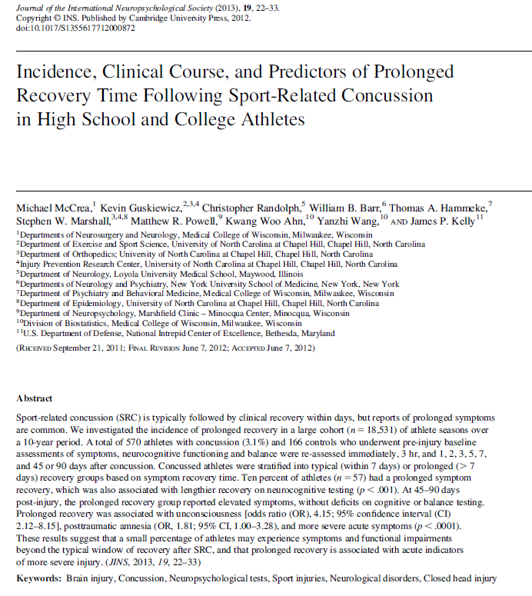
Concussed athletes (n=570)
High school 60% : Collegiate 40%
Non-concussed athlete controls (n=166)
Grouped based on day 1 v 7 Sx change:
Prolonged Recovery (PR; 95%ile)
Typical Recovery (TR; 1-94%ile)
Non-Concussed (NC)
No baseline differences PR/TR/NC:
Demo, concussion hx, baseline test

Slide 9
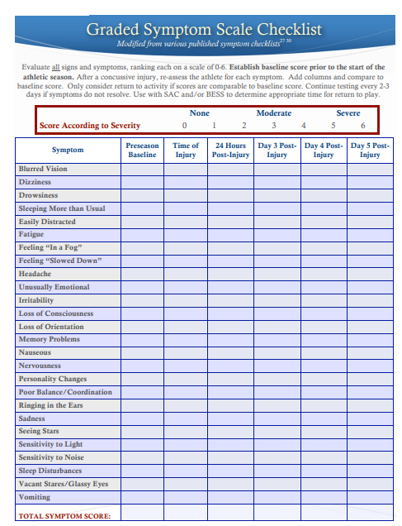
http://dhhs.ne.gov

Slide 10
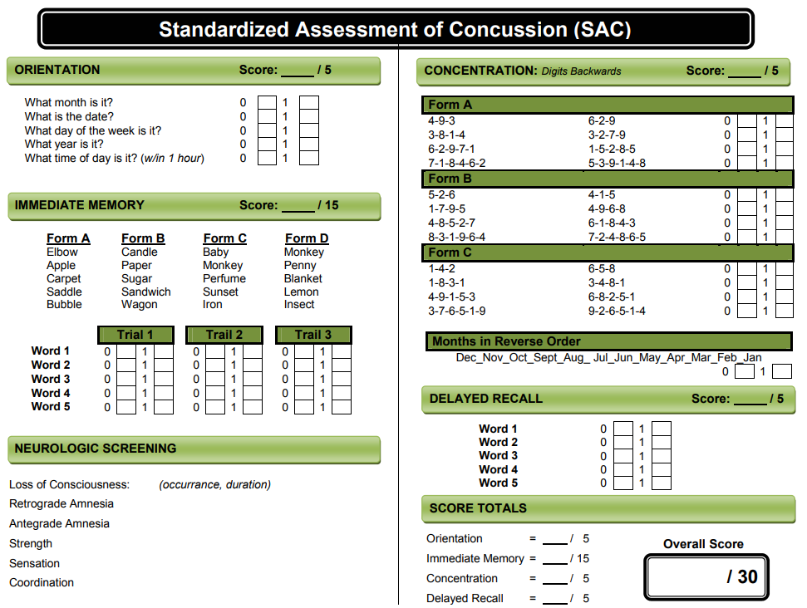
www.newburghschools.org

Slide 11
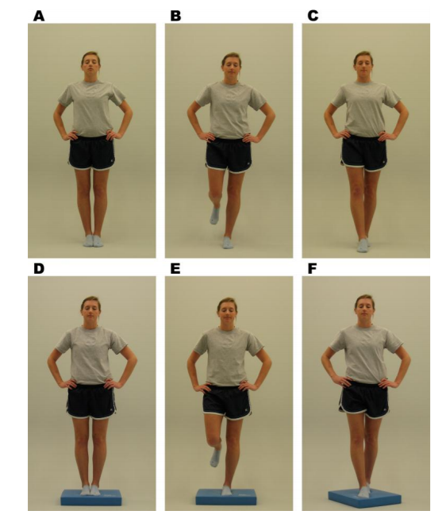
Balance Error Scoring System (BESS) Developed by researchers and clinicians at the University of North Carolina’s Sports Medicine Research Laboratory, Chapel Hill, NC 27599-8700

Slide 12
Sports Concussion Study Take Away
Multiple aspects of recovery (cognitive, Sx, balance)
Subgroups of concussed athletes recover differently
Minority remain mildly symptomatic at 3 months
Initial symptom presentation predicts recovery

Slide 13
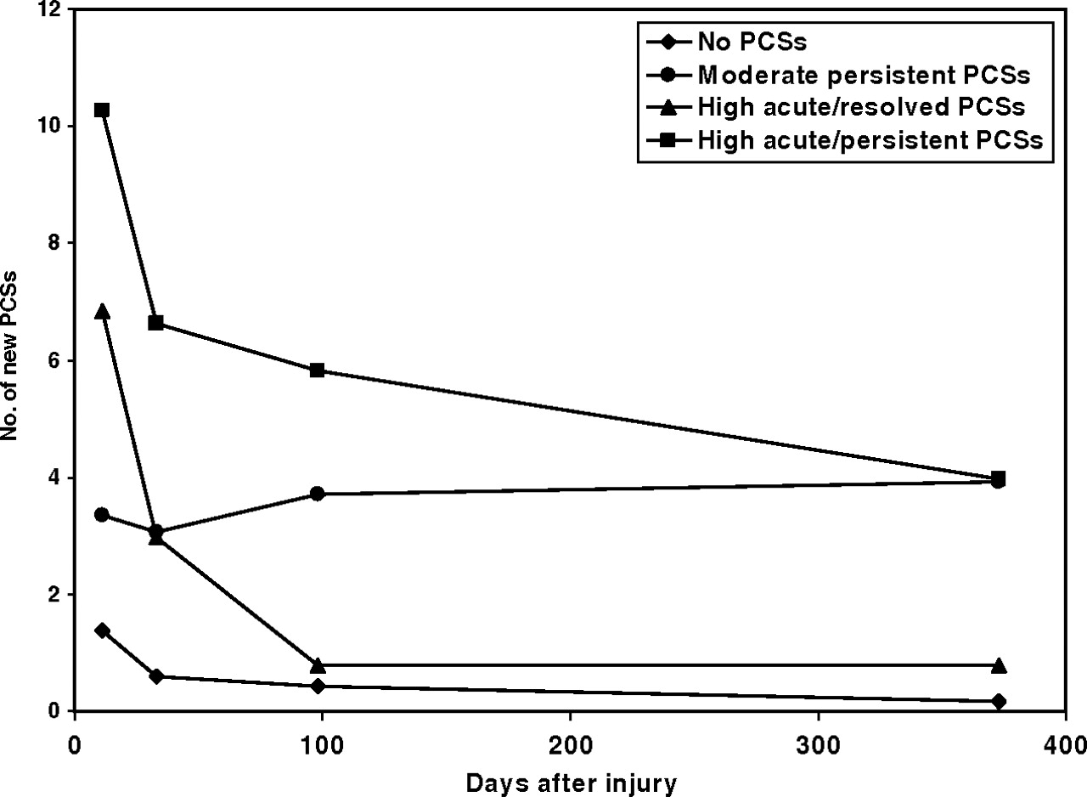

PCS trajectory groups.
Age 8-15
Moderate = 61% TBI
Sx typically improve
2/3 of TBI group were in No-PCS group
Keith Owen Yeates et al. Pediatrics 2009;123:735-743
©2009 by American Academy of Pediatrics

Slide 14
ED-Served Study Take Away
Age factors in concussion recovery (ages and stages)
Non-sports concussions show less clear recovery
Concussion symptoms are seen in non-concussed kids
Majority of concussed kids spontaneously recover (Sx)
There are other variables at play besides the concussion

Slide 15
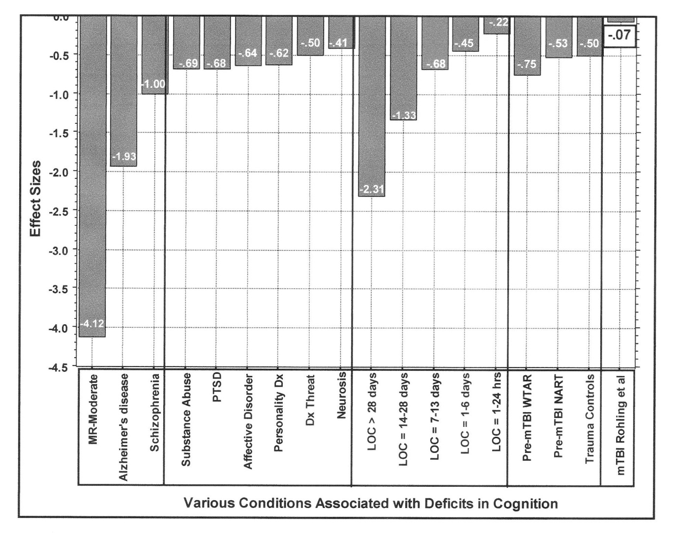
Effect Sizes of Various Conditions Compared to mTBI
Larrabee & Rohling, 2013, Behavioral Sciences & the Law
Orthopedic Controls.

Slide 16
Recovery on IQ
TBI Severity & Age at injury [Anderson, et al., 2005]

Slide 17
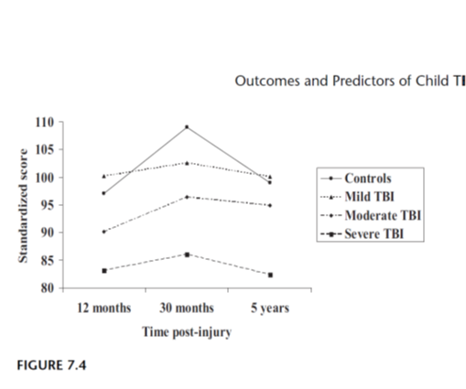
Recovery on Academics
Children injured between 1-7 years old
Educational Functioning

Slide 18
Recovery on Academics

Slide 19
Recovery on Adaptive and Bx
Cattropa, et al., 2008

Slide 20
Predictors of Outcome (Catroppa, et al, 2014)
Injury characteristics:
  Severity
  Extent of damage
  Secondary injuries
Developmental factors:
  Timing and Location
Pre-injury factors:
  Genetic, cognitive, gender, healthy behaviors, symptoms (HA)
Environmental factors:
  SES, family, social
Genetic:
  TBD

Slide 21
TBI Take
TBI severity is on a continuum from microscopic and transient – to – structural and permanent
There is much more than just cognitive/learning affected by brain injuries
Clinical presentation is extremely variable and individual
Recovery is influenced by genetic, physiological, individual, and social factors
Treatment will require proactive planning, collaboration, and creativity

Slide 22

Accommodations & Interventions

Slide 23
CDC Guidelines (2018)
Synopsis of the “Shoulds”
TREATMENT
Restrict physical and cognitive activity first several days
Then, resume gradual schedule of activity not exacerbating Sx
  Ideally after 48 hours of injury (Davis, 2017; Schneider, 2017)
Resume normal activities when at baseline and symptom-free (rest & physical exertion)

Slide 24
CDC Guidelines (2018)
Synopsis of the “Shoulds”
TREATMENT
Return to School:
  Gradually increase duration and intensity as tolerated
  Customize return-to-school protocols (based on the kid)
  Consider formal educational supports in prolonged recovery (504/IEP)
  Collaborative monitoring of Sx and academic Fx
  Refer to specialist in pediatric mTBI if prolonged recovery

Slide 25
Return-to-school schedule
Stage | Activity
1 | Daily activities at home (no Sx increase)
2 | School activities (homework; reading, etc)
3 | Return to school part-time
4 | Return to school full-time
O’Neill, et al., 2017, Rehabilitation Psychology

Slide 26
Return-to-sport schedule
Stage | Activity
1 | Symptom-limited activity
2 | Light aerobic exercise
3 | Sport-specific exercise
4 | Non-contact training drills
5 | Full contact practice
6 | Return to sport

Slide 27
TBI Treatment Basics
Involve the family
Behavior intervention has best empirical support
Know your State laws and School policy
School providers are key
  Communication/collaboration
  Positive outlook
  Proactive planning
  Flexibility

Slide 28
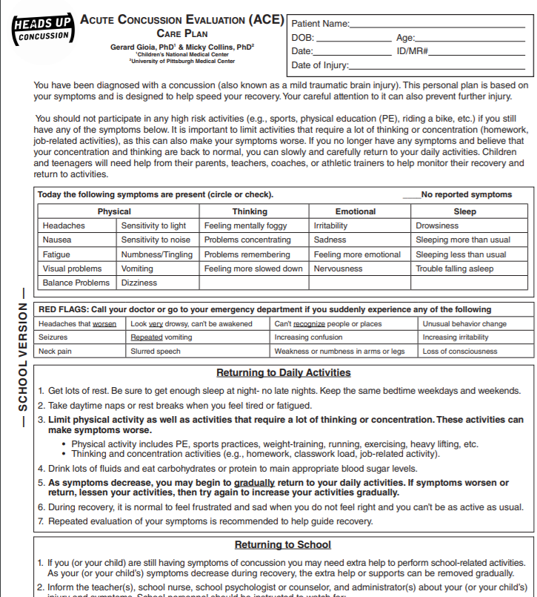
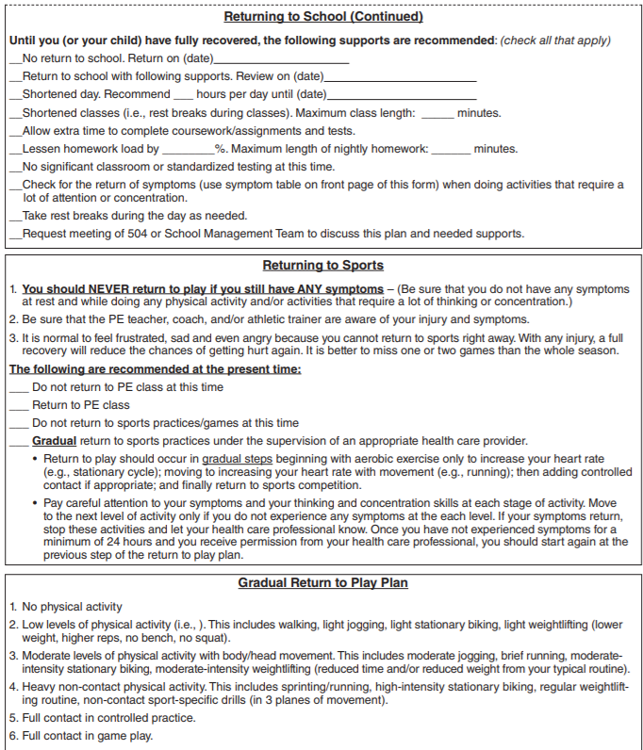

Slide 29
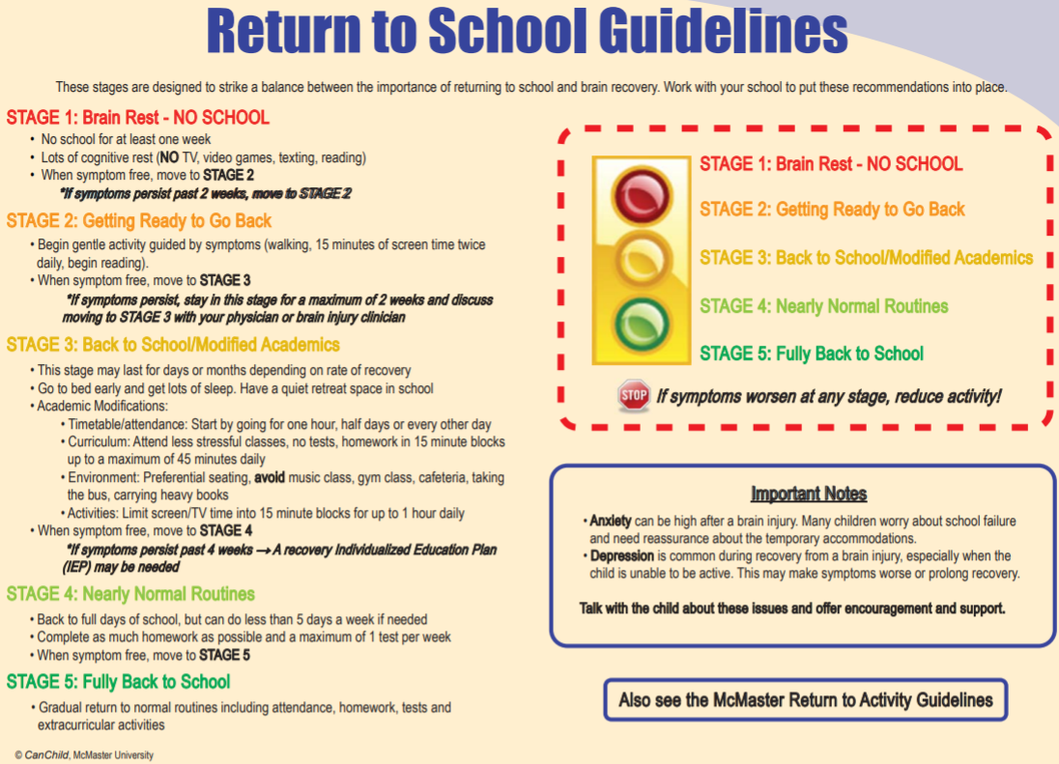
www. canchild.ca

Slide 30
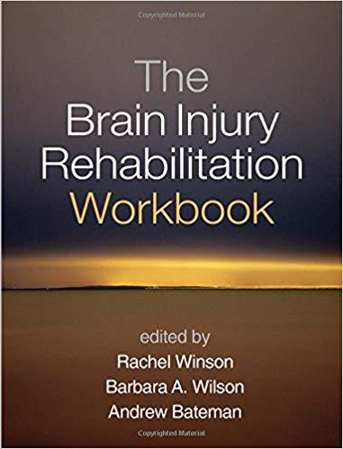

Slide 31
Cognitive Rehabilitation: Fatigue
What:
  Physical, Mental, Emotional
  Complex Interactive Cycles: [primary v secondary; physiological v psychological)
    Therefore, combination of interventions work best
Try This:
  Cover medical bases
  Outside school options (sleep, exercise, nutrition)
  Talk about it (what you see/they feel, triggers, patterns, coping)
  Experiment…

Slide 32
Cognitive Rehabilitation: Fatigue
Experiment Options:
  Analogies (gas, batteries, wi-fi signal)
  List options to recharge energy (gas station, chargers)
  Use visual supports (gauges, graphs, scales, stoplights) for insight/prompt
    Intervene at or before 50%
  3 P’s [PACE – PRIORITIZE – PLAN]
    Pace: scheduled breaks, relaxation
    Prioritize: Importance/Urgency/Enjoyment
    Plan: Begin with the end in mind, when most refreshed, bank of coping options

Slide 33
Cognitive Rehabilitation: Attention
What:
  Alerting – Orienting – Executing
Try This:
  Metaphor (flashlight, lighthouse)
  Environment (reduce distractors, visual prompts)

Slide 34
Cognitive Rehabilitation: Executive
What:
  Thermostat and Coach
Try This:
  Metacognitive Strategy Instruction (self-monitoring, self-regulation)
  Problem Solving Strategy Instruction
  Use BRIEF-2

Slide 35
Cognitive Rehabilitation: Executive
Inhibition:
  Stop/Think
Flexibility:
  Zoom In/Out
Regulation:
  Motivational Interviewing, Relaxation Techniques, Self-Monitoring
Initiation:
  Alerts, motivate, ramp-up
Planning/Organizing:
  Planner/Organizer
Problem Solving:

Slide 36
Cognitive Rehabilitation: Memory
What:
  Types: Procedural v Explicit
  Processes: Encoding v Retrieving
Try This:
  Errorless Learning Chunking
  Spaced Retrieval Visual Imagery
  Retrieval Practice Mnemonics
  Associations Mindmaps
  External Aides

Slide 37
Resources
Missouri State High School Activities Association
  www.mshsaa.org
Centers for Disease Control & Prevention
  www.cdc.gov/traumaticbraininjury/
Concussion Management – The Team Plan
  https://health.mo.gov/living/families/shcn/pdf/ConcussionManagement.pdf
Missouri Department of Health & Senior Services
  health.mo.gov/living/healthcondiseases/tbi/
Nationwide Children’s
  https://www.nationwidechildrens.org/specialties/concussion-clinic
BrainSTEPS (www.brainsteps.net)
McMaster (canchild.ca)

